Slide 1
WHAT IS SECURITY ENGINEERING ?
Security Engineering is the third layer of the Security Transformation Model
Consists of more in-depth and complicated security activities which take more time and effort
Many times related to security architecture

Slide 2
WHAT IS SECURITY ENGINEERING ?
SECURITY
TRANSFORMATION
MODEL
4. Security Governance
3. Security Engineering
2. Vulnerability Management
1. Security Hardening

Slide 3
WHAT IS SECURITY ENGINEERING ?
Types of activities for security engineering:
FW granular access lists
Building an effective DMZ architecture
Segregating the network with VLANs
Adding a security tool such as SIEM, FW, DLP, NAC, etc
App-DB encryption

Slide 4
WHAT IS SECURITY ENGINEERING ?
DMZ Architecture Case Study:
DMZ is an important zone in the overall security architecture
Devices which need to communicate to outside world placed in DMZ
Web servers, email gateways, web gateways

Slide 5
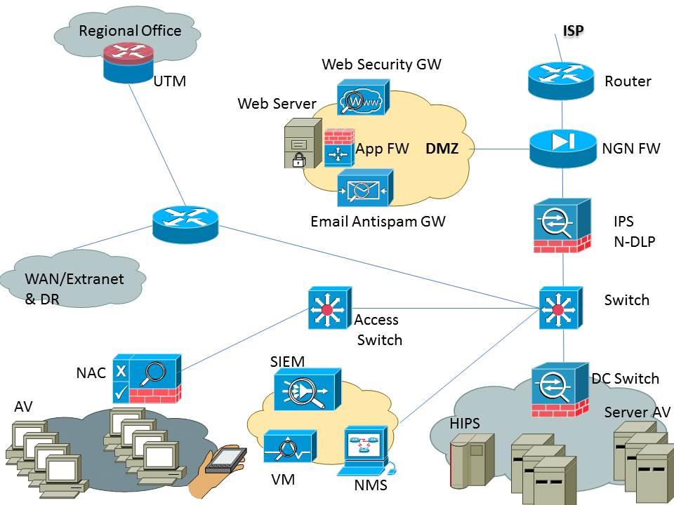
WHAT IS SECURITY ENGINEERING ?

Slide 6
WHAT IS SECURITY ENGINEERING ?
FW Access List Case Study:
Most of the industry has not worked on building granular access lists
Most FWs have “allow all” for traffic
Granular access lists need to be built based on servers, or traffic flows

Slide 7
WHAT IS SECURITY ENGINEERING ?
Why at Layer 3 of Security Transformation Model ?
Low hanging fruit first
Teams tend to get bogged down with advanced security tasks
These take time, effort, and often budget approval
END

